Slide 1
Data Structures
Sorting
Haim Kaplan & Uri Zwick
December 2014

Slide 2
Comparison based sorting
key
a₁
a₂
a_{n}
info
Input: An array containing n items
Keys belong to a totally ordered domain
Two keys can be compared in O(1) time
Output: The array with the items reordered so that a₁ ≤ a₂ ≤ … ≤ a_{n}
“in-place sorting”
info may contain initial position

Slide 3
Comparison based sorting
Insertion sort
Bubble sort
O(n²)
Balanced search trees
Heapsort
Merge sort
O(n log n)
O(n log n)
expected time
Quicksort

Slide 4
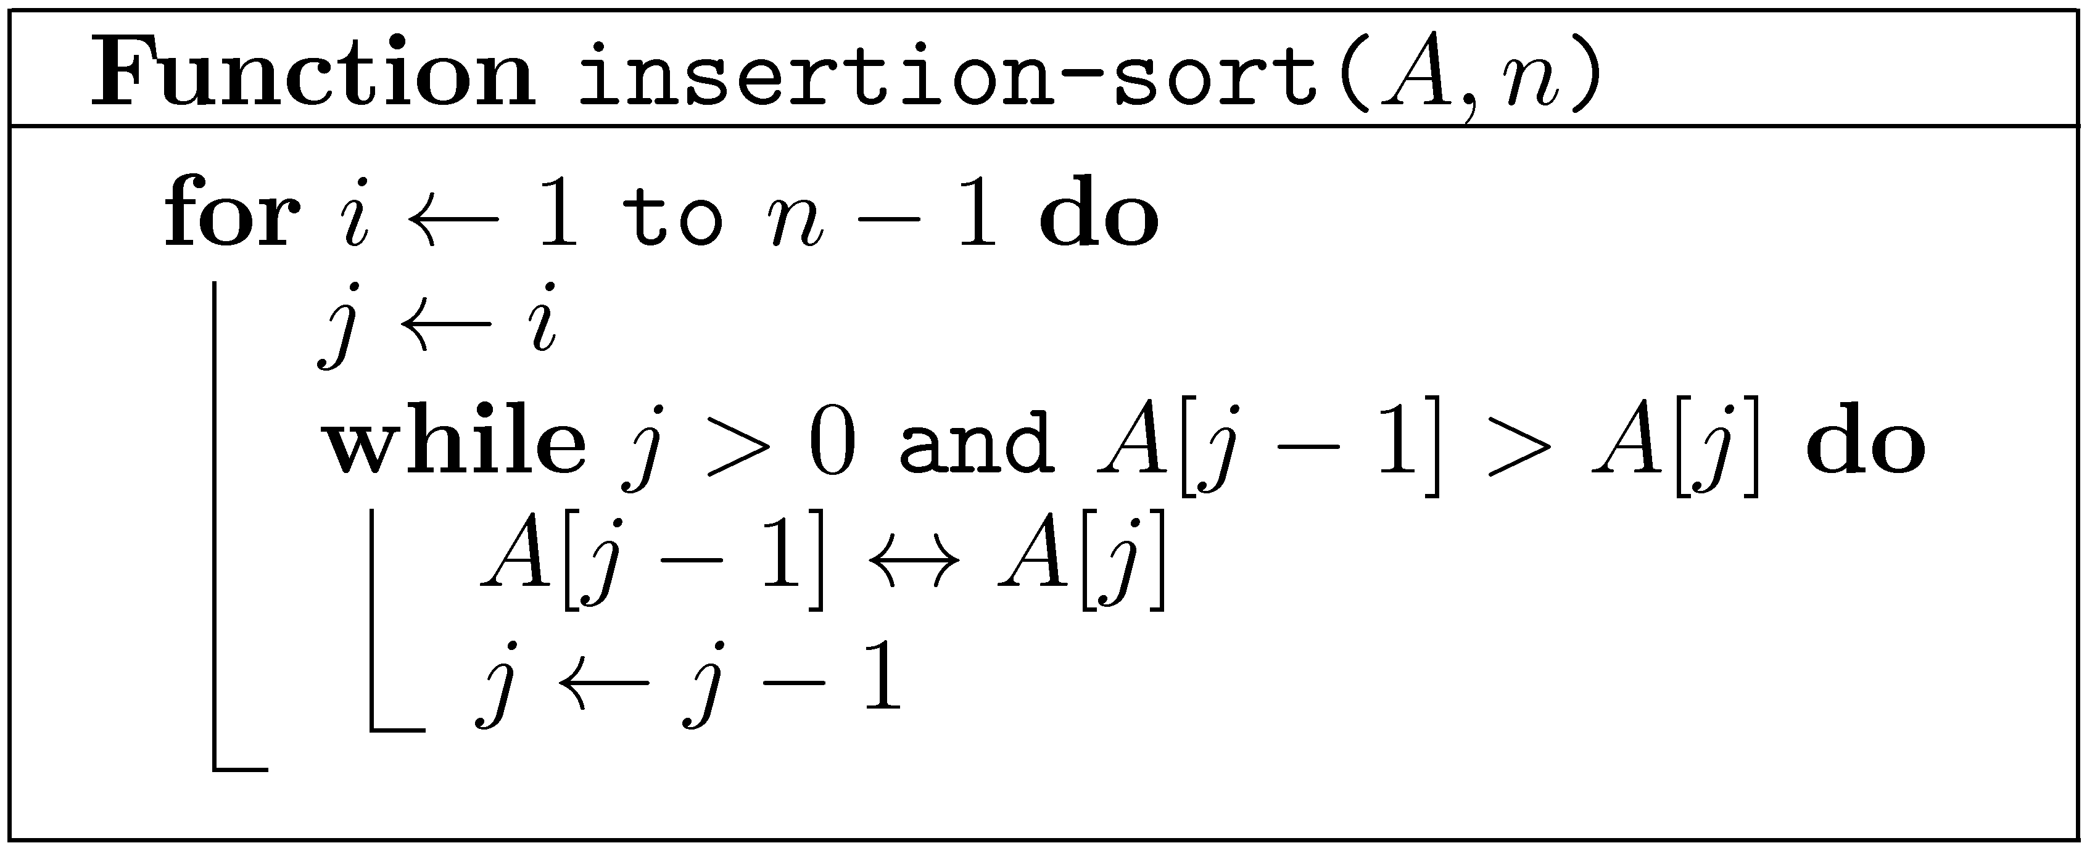
Warm-up: Insertion sort
Worst case O(n²)
Best case O(n)
Efficient for small values of n

Slide 5
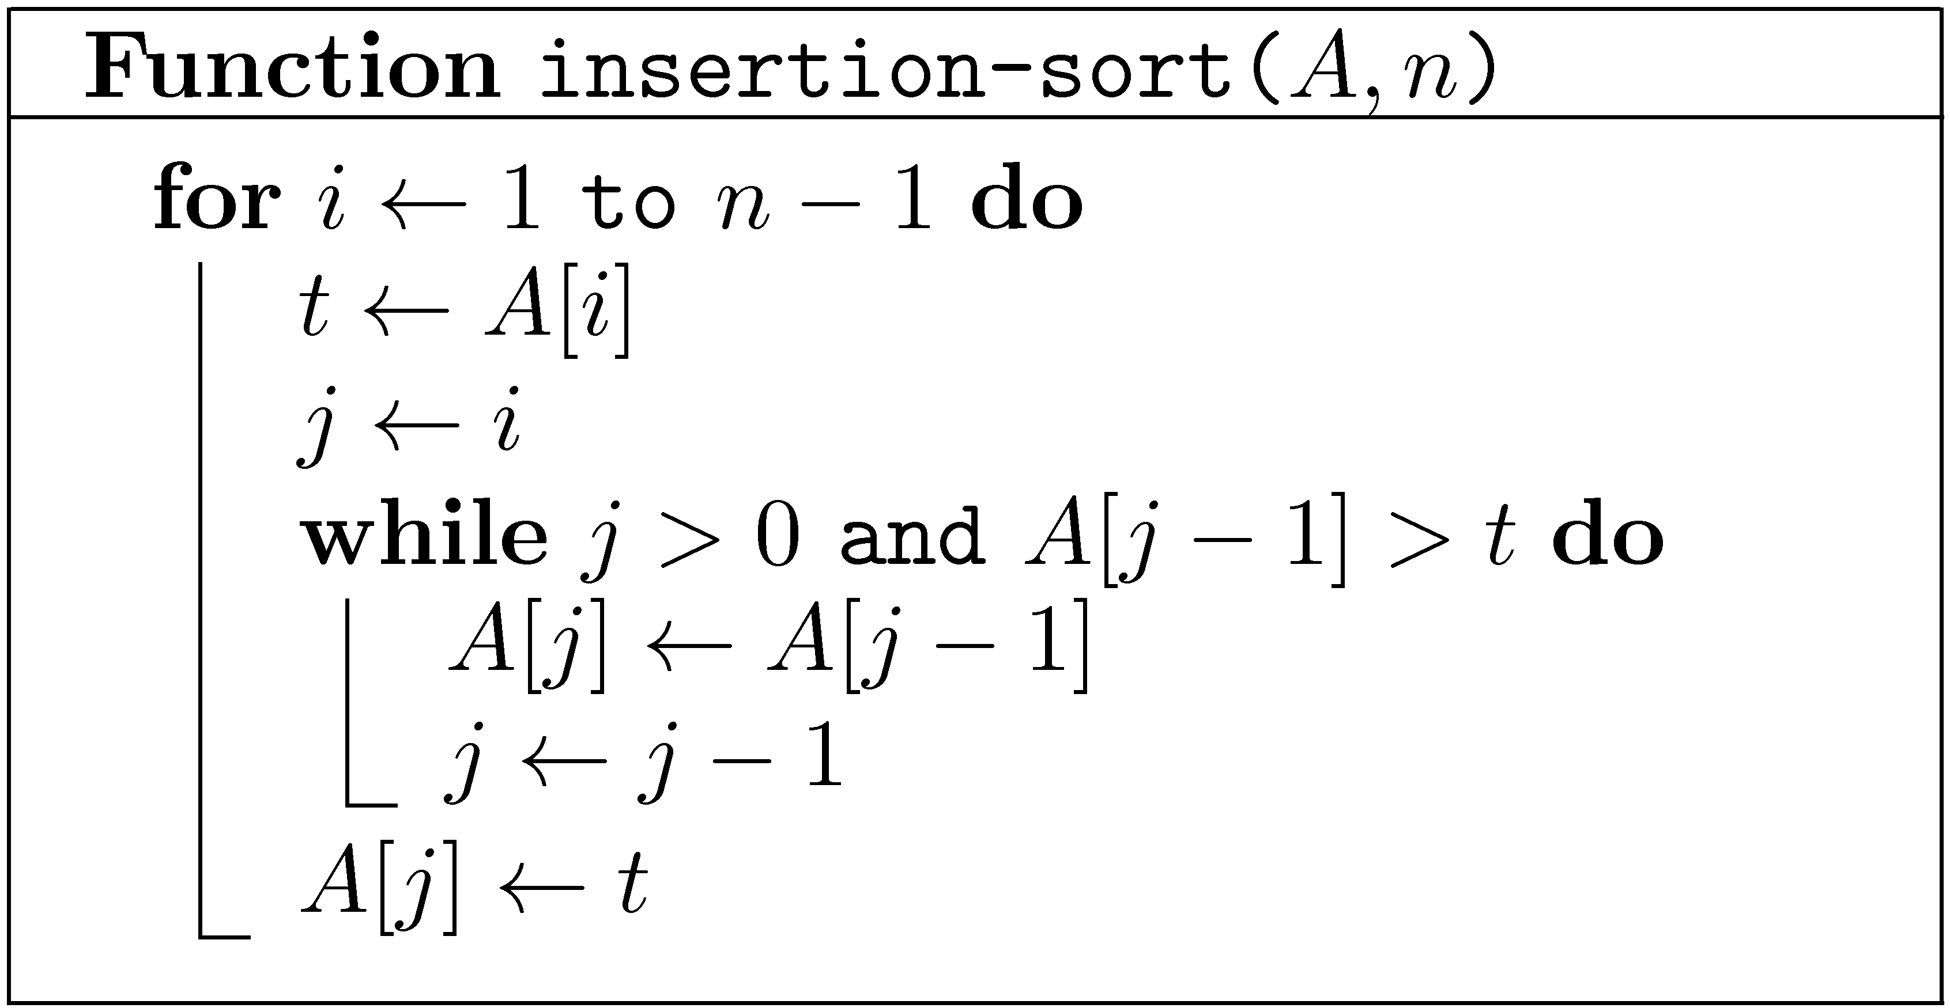
Warm-up: Insertion sort
Slightly optimized. Worst case still O(n²)
Even more efficient for small values of n

Slide 6
Warm-up: Insertion sort
(Adapted from Bentley’s Programming Peals, Second Edition, p. 116.)

Slide 7
AlgoRythmics
Insertion sort
Bubble sort
Select sort
Shell sort
Merge sort
Quicksort

Slide 8
Quicksort [Hoare (1961)]

Slide 9
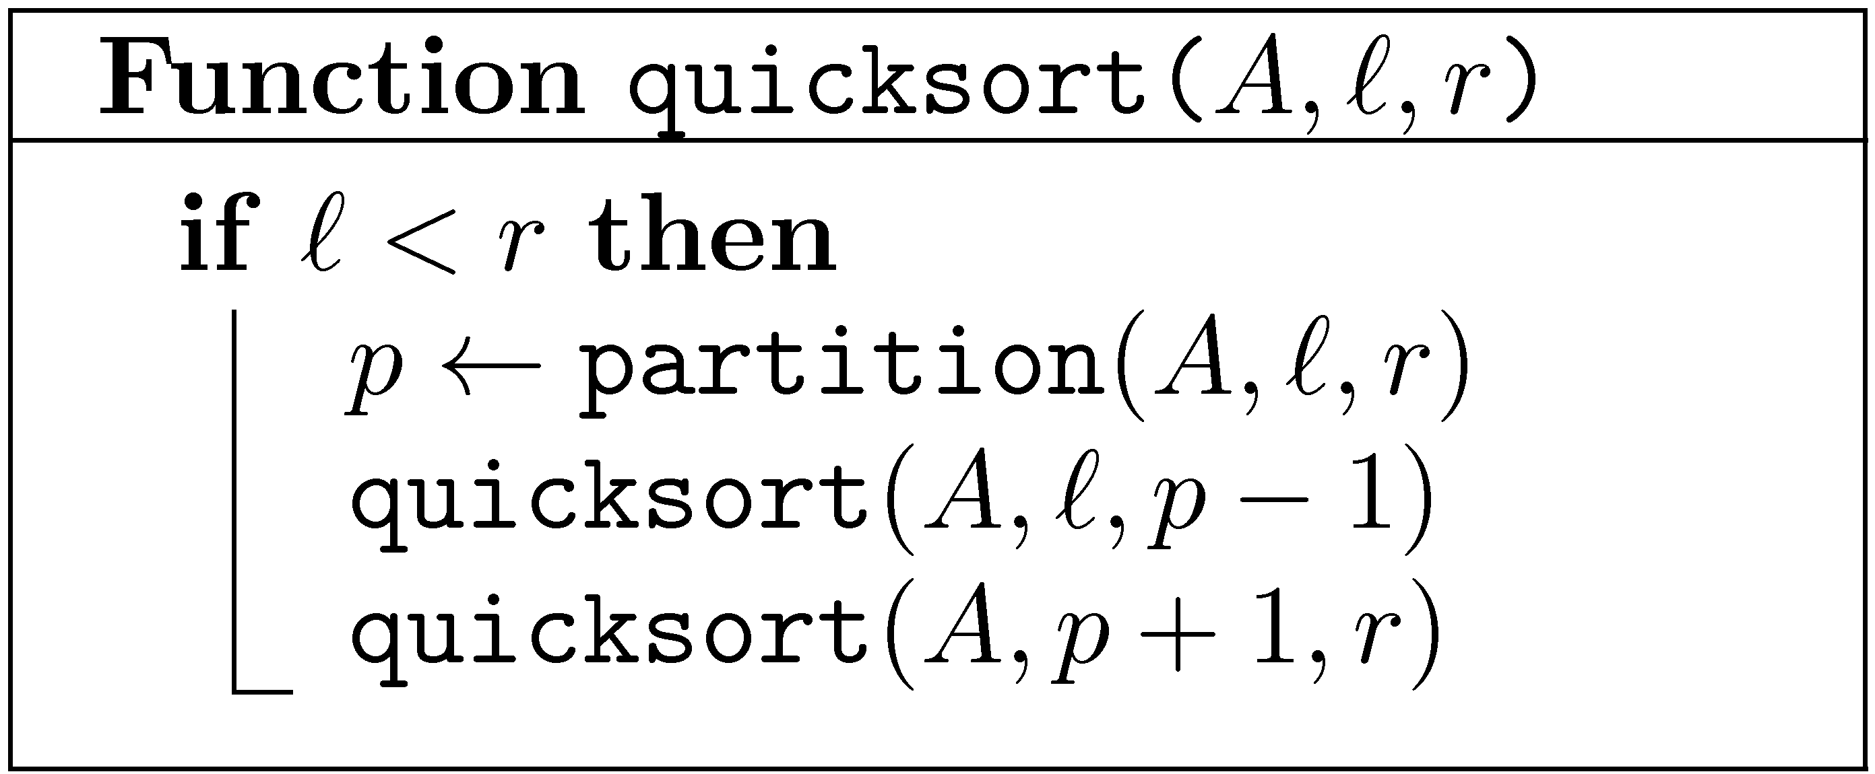



Quicksort
< A[p]
≥ A[p]

Slide 10


partition
If A[j] ≥ A[r]
< A[r]
≥ A[r]
< A[r]
≥ A[r]

Slide 11
partition
If A[j] < A[r]
< A[r]
≥ A[r]
< A[r]
≥ A[r]

Slide 12
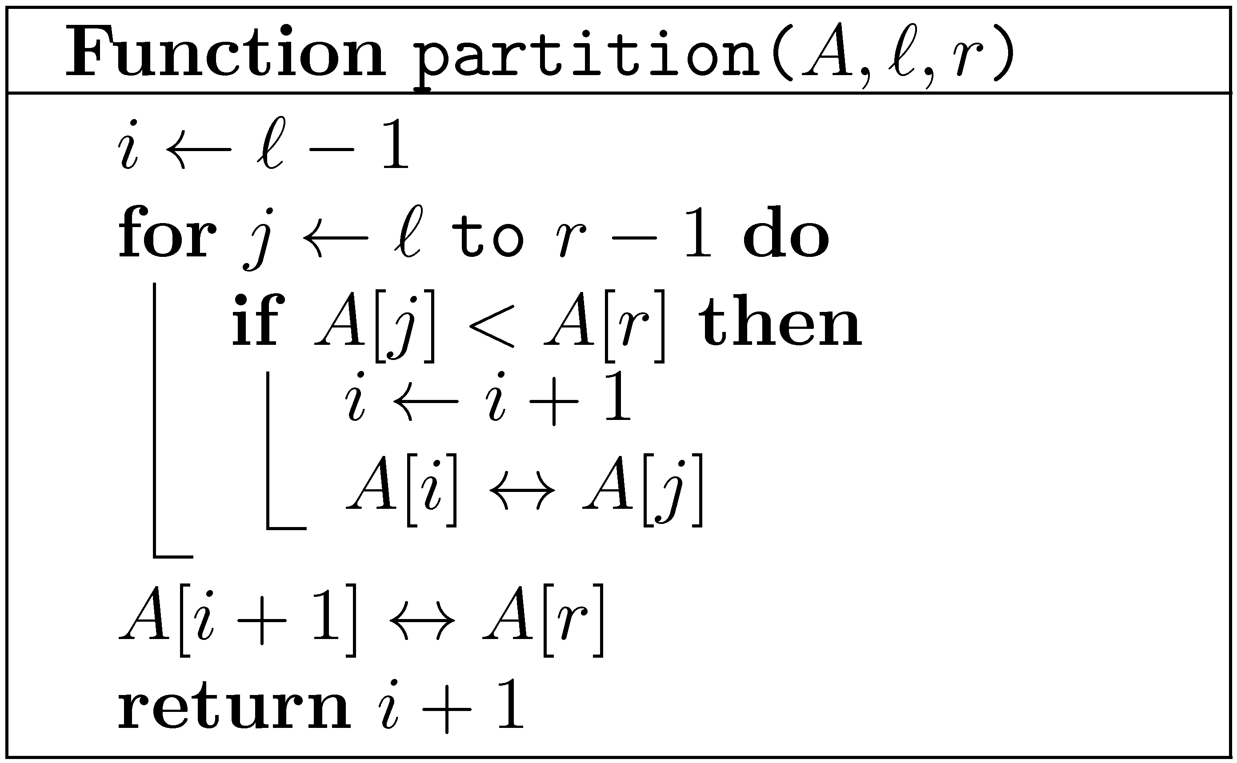
p
r
Lomuto’s partition
< A[r]
≥ A[r]

Slide 13
partition
Use last key as pivot
2
8
7
1
3
5
6
4
2
8
7
1
3
5
6
4
(Is it a good choice?)
2
8
7
1
3
5
6
4
i – last key < A[r]
2
8
7
1
3
5
6
4
j – next key to inspect
2
1
7
8
3
5
6
4

Slide 14
i
j
2
1
7
8
3
5
6
4
i
j
2
1
3
8
7
5
6
4
i
j
2
1
3
8
7
5
6
4
i
j
2
1
3
8
7
5
6
4
Move pivot into position
i
j
2
1
3
4
7
5
6
8

Slide 15
Hoare’s partition
≤ A[r]
≥ A[r]
Performs less swaps than Lomuto’s partition
Produces a more balanced partition when keys contain repetitions.
Used in practice

Slide 16
Hoare’s partition
A[i] < A[r]
≤ A[r]
≥ A[r]
≤ A[r]
≥ A[r]

Slide 17
Hoare’s partition
A[j] > A[r]
≤ A[r]
≥ A[r]
≤ A[r]
≥ A[r]

Slide 18
Hoare’s partition
A[i] ≥ A[r] , A[j] ≤ A[r]
≤ A[r]
≥ A[r]
≤ A[r]
≥ A[r]

Slide 19
Analysis of quicksort
Best case: n → (n−1)/2 , 1 , (n − 1)/2
Worst case: n → n−1 , 1 , 0
Average case: n → i−1 , 1 , n−i
where i is chosen randomly from {1,2,…,n}
Worst case obtained when array is sorted…
Average case obtained when array is in random order
Let C_{n} be the number of comparisons performed

Slide 20
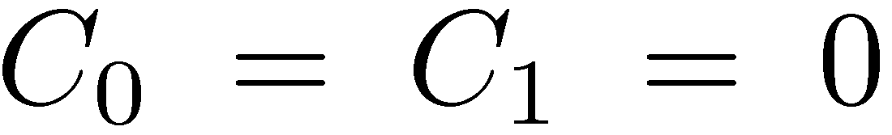
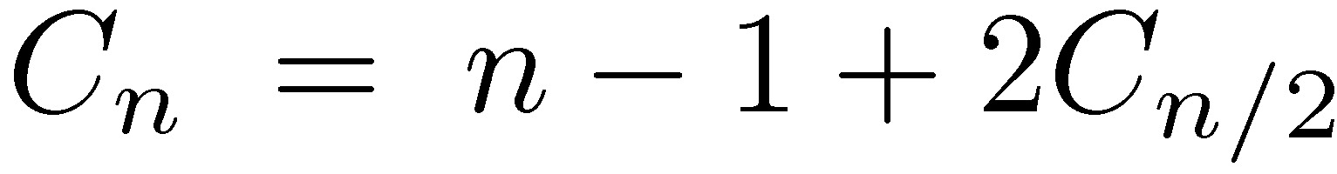
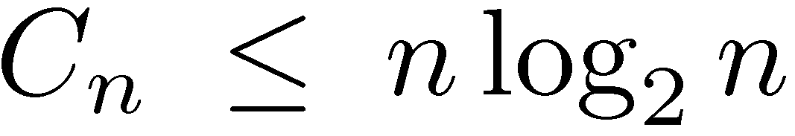
Best case of quicksort
By easy induction

Slide 21

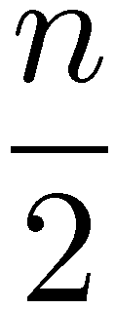
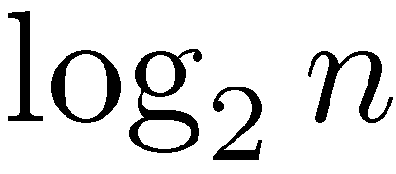
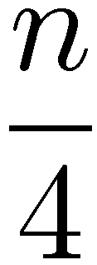

Best case of quicksort
…

Slide 22
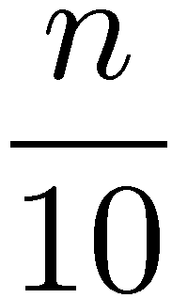
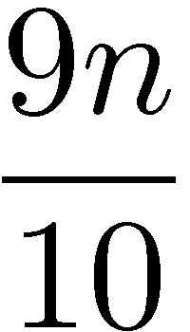
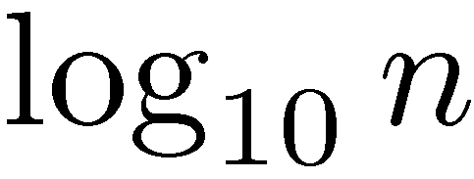
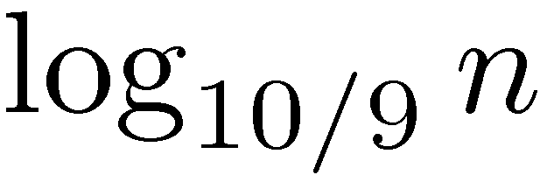
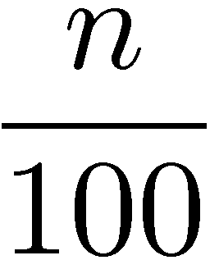
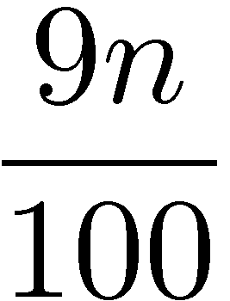
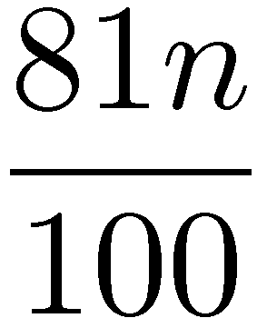
“Fairly good” case of quicksort
…

Slide 23
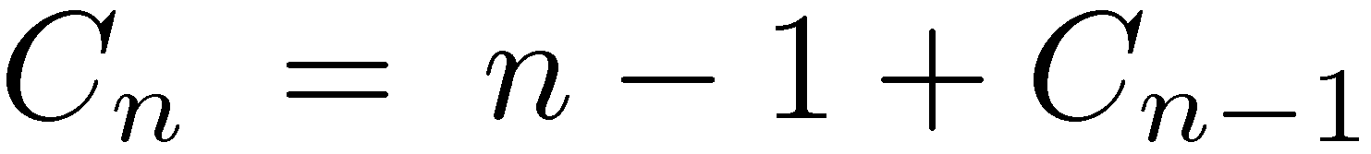
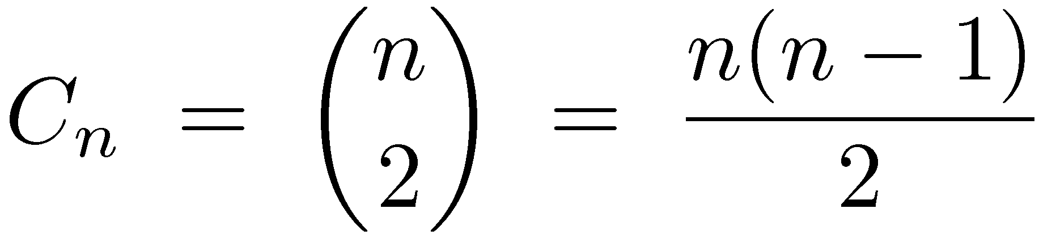
Worst case of quicksort
By easy induction

Slide 24
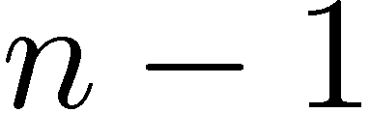
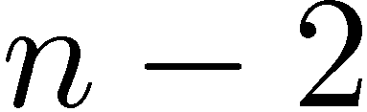
Worst case of quicksort
…
Worst case is really bad
Obtained when array is sorted…

Slide 25
How do we avoid the worst case?
Use a random item as pivot
Running time is now a random variable
“Average case” now obtained for any input
For any input, bad behavior is extremely unlikely
For simplicity, we consider the expected running time, or more precisely, expected number of comparisons

Slide 26
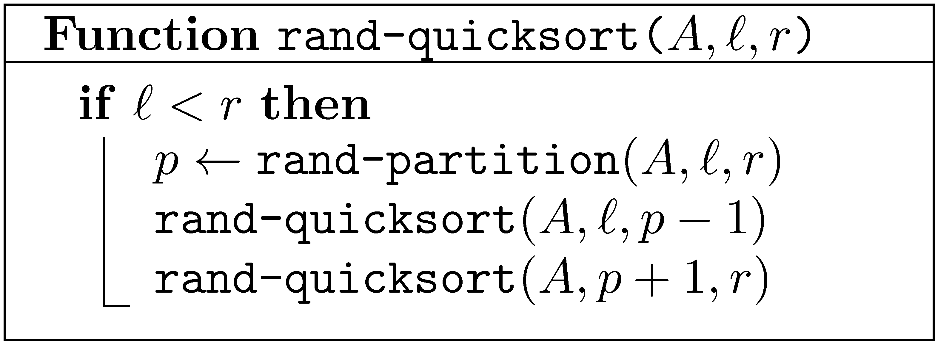
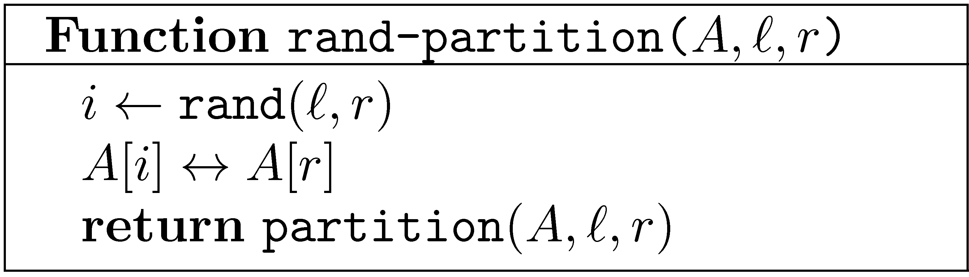
Randomized quicksort
(How do we generate random numbers?)

Slide 27
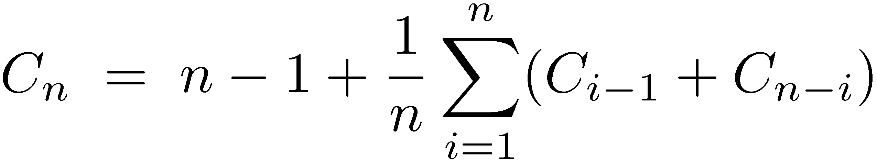
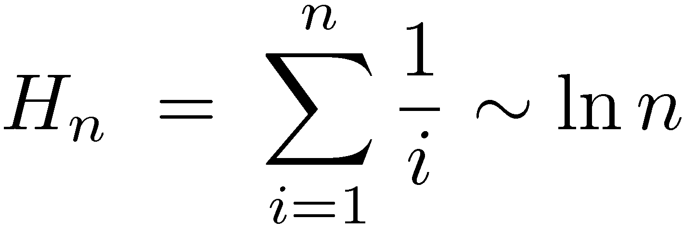
Analysis of (rand-)quicksort using recurrence relations
(Actually, not that complicated)
P2C2E

Slide 28
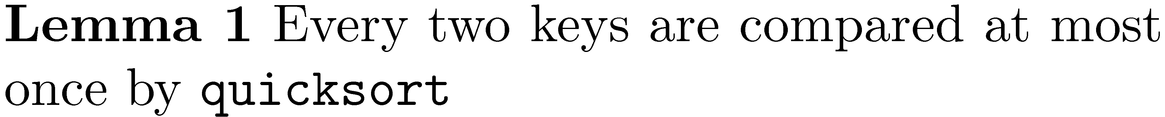
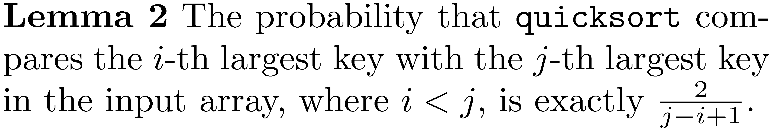
Analysis of (rand-)quicksort

Slide 29
Analysis of (rand-)quicksort
Let the input keys be z₁ < z₂ < … < z_{n}
Proof by induction on the size of the array
Basis: If n=2, then i=1 and j=2, and the probability that z₁ and z₂ are compared is indeed 1

Slide 30
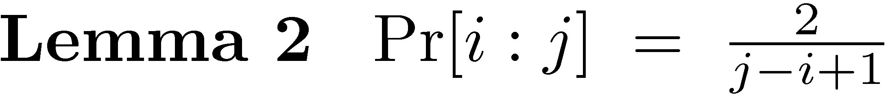
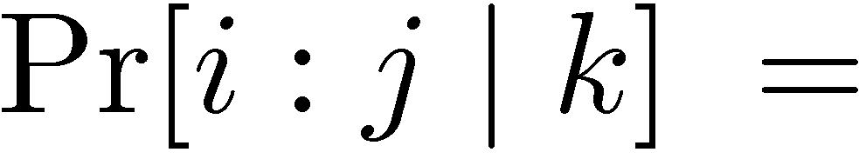
Analysis of (rand-)quicksort
Induction step: Suppose result holds for all arrays of size < n
Let z_{k} be the chosen pivot key
The probability that z_{i} and z_{j} are compared, given that z_{k} is the pivot element

Slide 31
Analysis of (rand-)quicksort
Let z_{k} be the chosen pivot key
If k<i, both z_{i} and z_{j} will be in the right sub-array, without being compared during the partition. In the right sub-array they are now z’_{i−k} and z’_{j−k}.
If k>j, both z_{i} and z_{j} will be in the left sub-array, without being compared during the partition. In the left sub-array they are now z’_{i} and z’_{j}.
If k=i or k=j, then z_{i} and z_{j} are compared
If i<k<j, then z_{i} and z_{j} are not compared

Slide 32
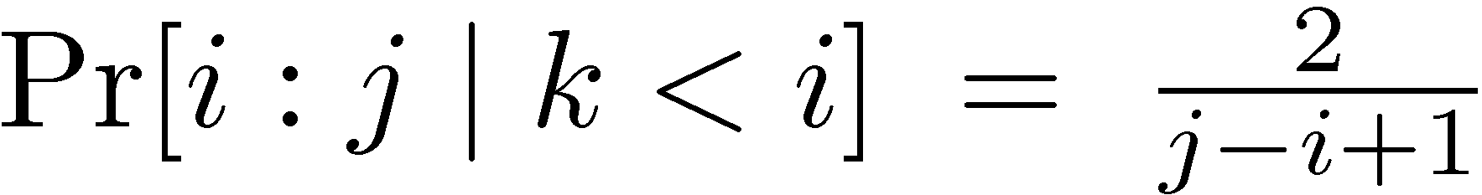
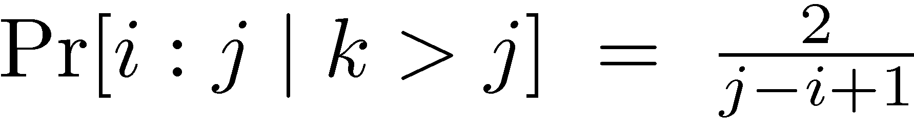
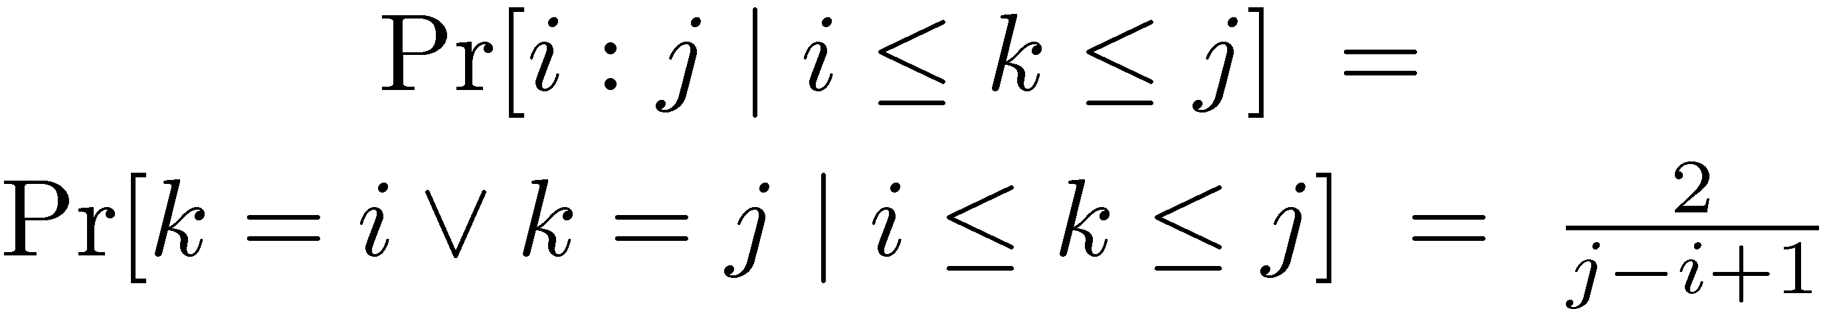
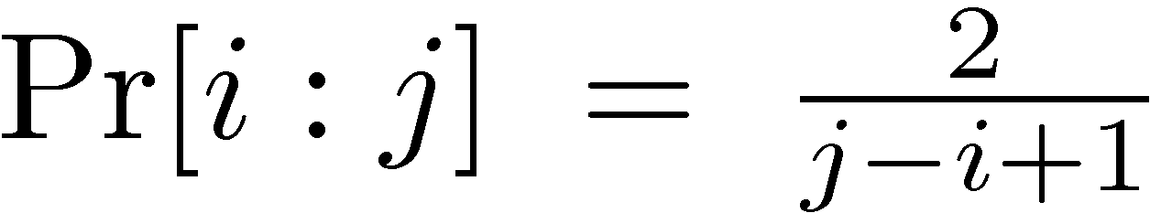
Analysis of (rand-)quicksort
(by induction)
(by induction)

Slide 33
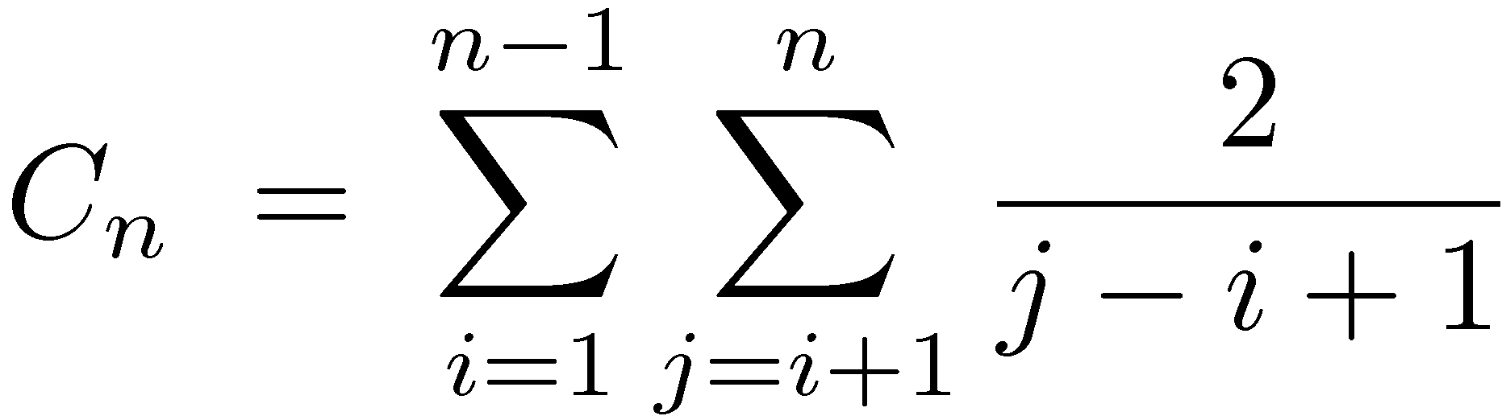
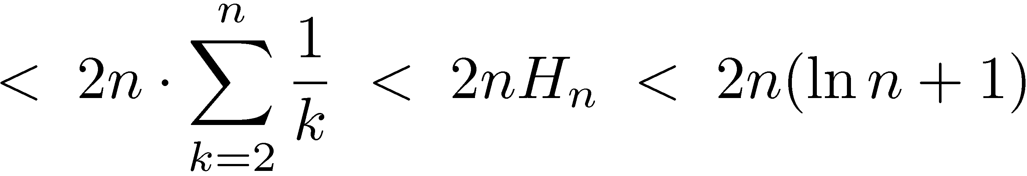
Analysis of (rand-)quicksort

Slide 34
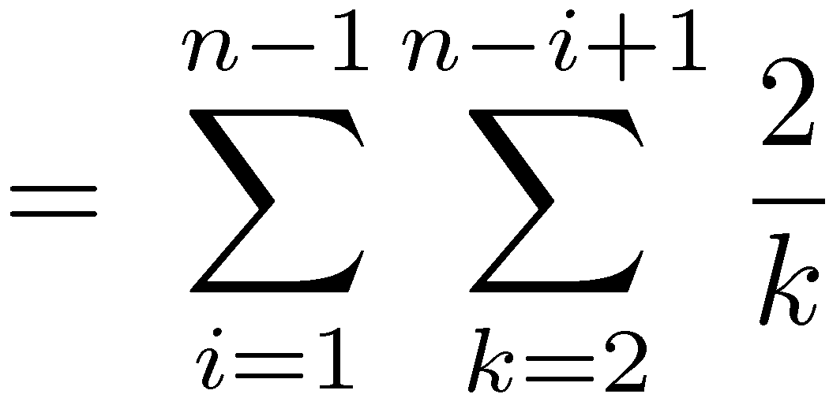
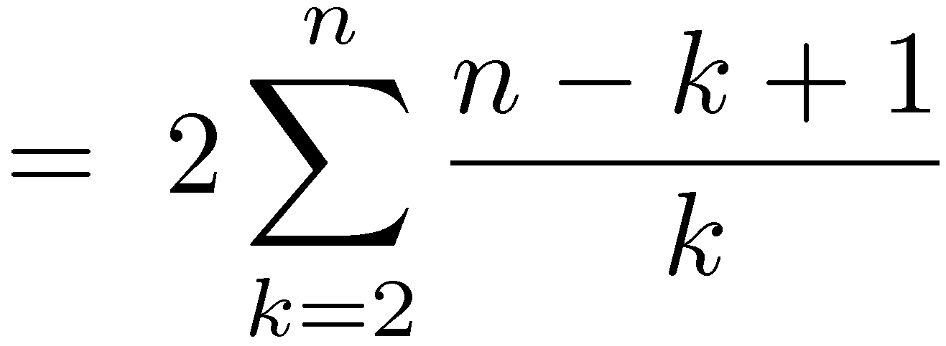
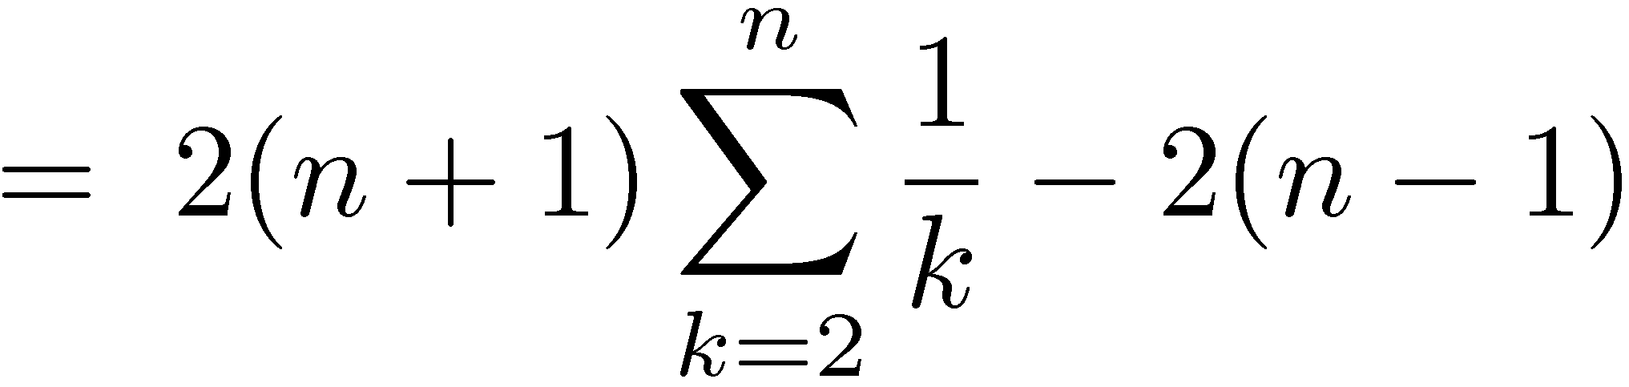
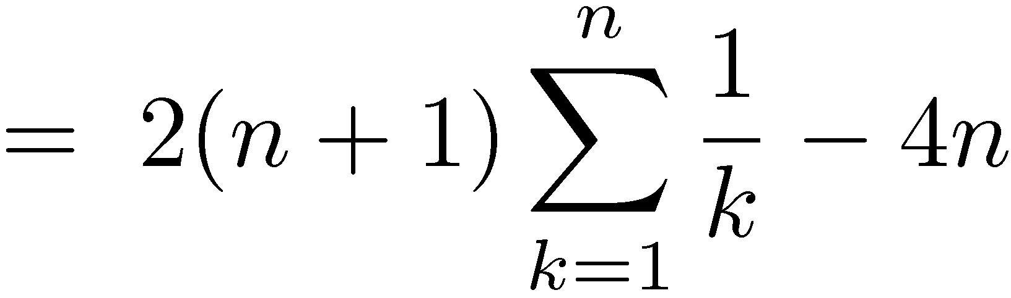
Analysis of (rand-)quicksort Exact version

Slide 35
Lower bound for comparison-based sorting algorithms

Slide 36
The comparison model
Items to be sorted
a₁ , a₂ , … , a_{n}
i : j
<
Sorting algorithm
The only access that the algorithm has to the input is via comparisons

Slide 37
comparison-based sorting algorithm
comparison tree

Slide 38
Insertion sort
x
y
z
x:y
<
>
x
y
z
y:z
x:z
y
x
z
<
>
>
x:z
x
z
y
y
x
z
y:z
y
z
x
x
y
z
<
>
<
>
x
z
y
z
x
y
y
z
x
z
y
x

Slide 39
Quicksort
x
y
z
x:z
<
>
y:z
y:z
<
>
<
>
x
y
z
x:y
x
z
y
y
z
x
x:y
z
x
y
<
>
<
>
x
y
z
y
x
z
z
x
y
z
y
x

Slide 40
Comparison trees
Every comparison-based sorting algorithm can be converted into a comparison tree.
Comparison trees are binary trees
The comparison tree of a (correct) sorting algorithm has n! leaves.
(Note: the size of a comparison tree is huge. We are only using comparison trees in proofs.)

Slide 41
Comparison trees
A run of the sorting algorithm corresponds to a root-leaf path in the comparison tree
Maximum number of comparisons is therefore the height of the tree
Average number of comparisons, over all input orders, is the average depth of leaves

Slide 42
Depth and average depth
Height = 3 (maximal depth of leaf)
1
2
Average depth of leaves = (1+2+3+3)/4 = 9/4
3
3

Slide 43
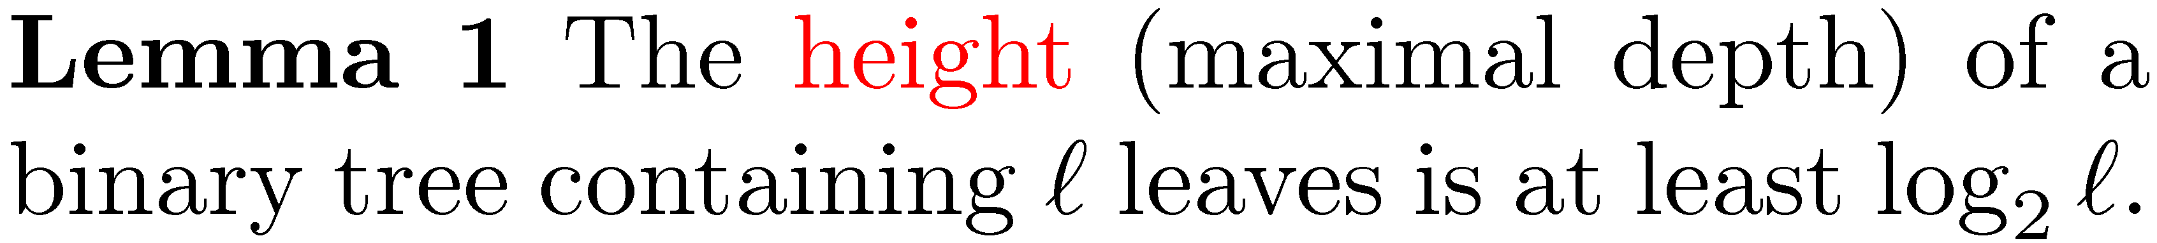
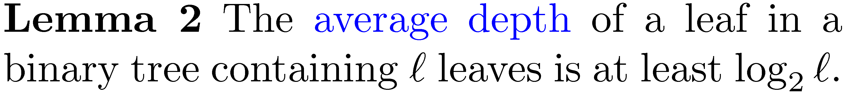
Maximum and average depth of trees
Lemma 2, of course, implies Lemma 1
Lemma 1 is obvious: a tree of depth k contains at most 2^{k} leaves

Slide 44
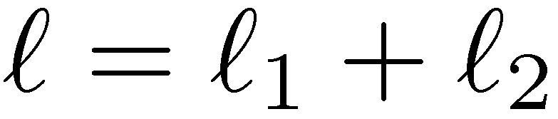
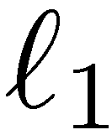
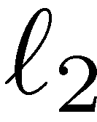
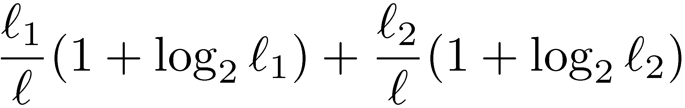
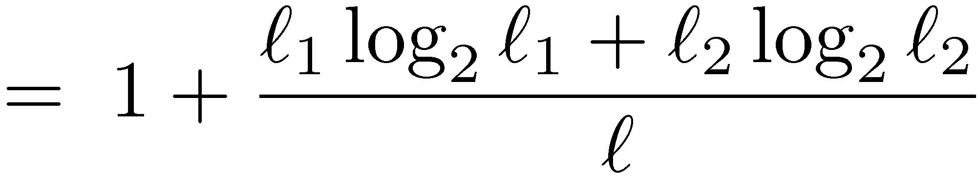
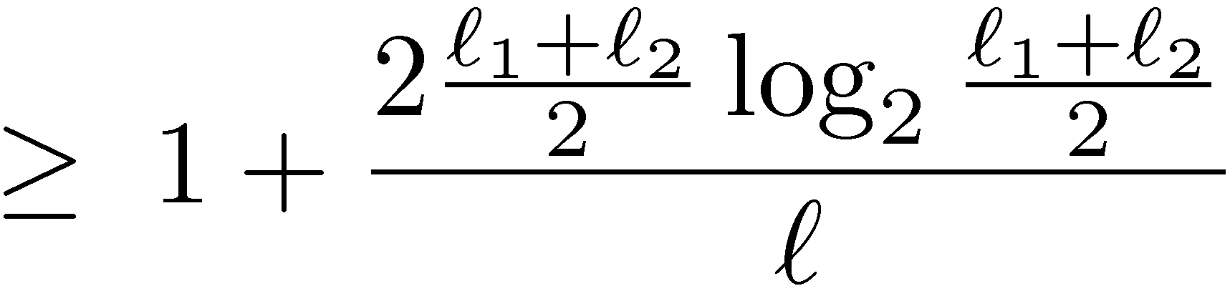
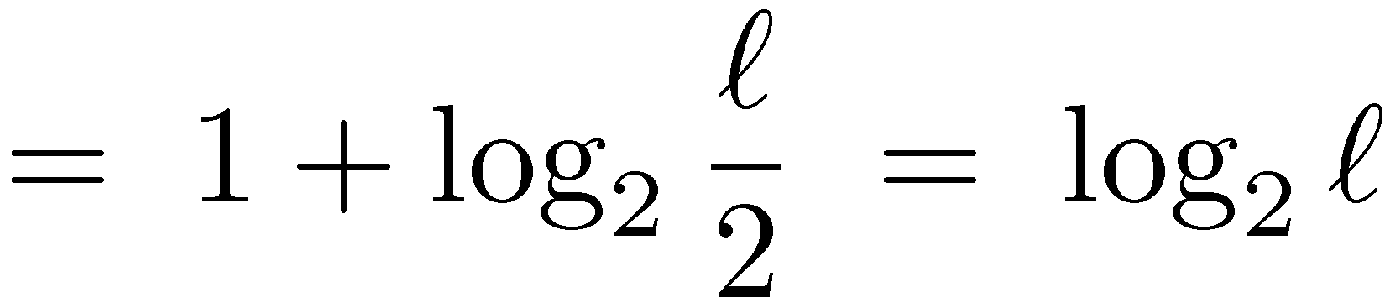
Average depth of trees
Proof by induction
(by induction)
(by convexity of x log x)

Slide 45
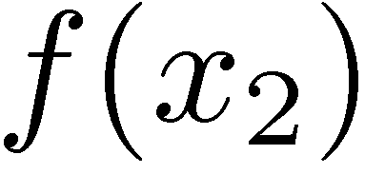
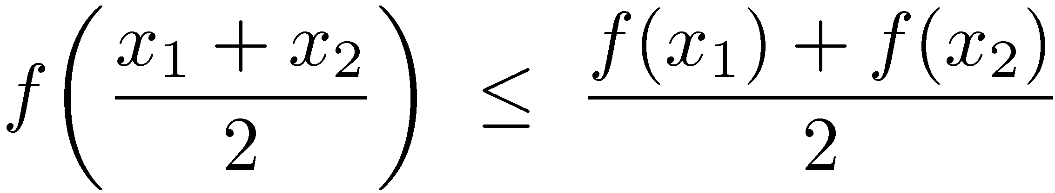




Convexity

Slide 46
Lower bounds
Theorem 1: Any comparison-based sorting algorithm must perform at least log₂(n!) comparisons on some input.
Theorem 2: The average number of comparisons, over all input orders, performed by any comparison-based sorting algorithm is at least log₂(n!).

Slide 47



Stirling formula

Slide 48




Approximating sums by integrals
f increasing

Slide 49
Randomized algorithms
The lower bounds we proved so far apply only to deterministic algorithms
Maybe there is a randomized comparison-based algorithm that performs an expected number of o(n log n) comparisons on any input?

Slide 50
Randomized algorithms
A randomized algorithm R may be viewed as a probability distribution over deterministic algorithms
R: Run D_{i} with probability p_{i} , for 1 ≤ i ≤ N
(Perform all the random choices in advance)

Slide 51

Notation
R: Run D_{i} with probability p_{i} , for 1 ≤ i ≤ N
R(x) - number of comparisons performed by R on input x (random variable)
D_{i}(x) - number of comparisons performed by D_{i} on input x (number)

Slide 52




More notation + Important observation
R: Run D_{i} with probability p_{i} , for 1 ≤ i ≤ N

Slide 53
Randomized algorithms
If the expected number of comparisons performed by R is at most f(n) for every input x,
then the expected number of comparisons performed by R on a random input is also at most f(n)
That means that there is also a deterministic algorithms D_{i} whose expected number of comparisons on a random input is at most f(n)
Thus f(n) = Ω(n log n)

Slide 54




Randomized algorithms

Slide 55
Lower bounds
Theorem 1: Any comparison-based sorting algorithm must perform at least log₂(n!) comparisons on some input.
Theorem 2: The average number of comparisons, over all input orders, performed by any comparison-based sorting algorithm is at least log₂(n!).
Theorem 3: Any randomized comparison-based sorting algorithm must perform an expected number of at least log₂(n!) comparisons on some input.

Slide 56
Beating the lower bound
We can beat the lower bound if we can deduce order relations between keys not by comparisons
Examples:
Count sort
Radix sort

Slide 57
Count sort
Assume that keys are integers between 0 and R−1
0
1
2
3
4
5
6
7
8
A
2
3
0
5
3
5
0
2
0

Slide 58
Count sort
Allocate a temporary array of size R: cell i counts the # of keys = i
0
1
2
3
4
5
6
7
8
A
2
3
0
5
3
5
0
2
5
C
0
0
0
0
0
0
0
1
2
3
4
5

Slide 59
Count sort
0
1
2
3
4
5
6
7
8
A
2
3
0
5
3
5
0
2
5
C
0
0
1
0
0
0
0
1
2
3
4
5

Slide 60
Count sort
0
1
2
3
4
5
6
7
8
A
2
3
0
5
3
5
0
2
5
C
0
0
1
1
0
0
0
1
2
3
4
5

Slide 61
Count sort
0
1
2
3
4
5
6
7
8
A
2
3
0
5
3
5
0
2
5
C
1
0
1
1
0
0
0
1
2
3
4
5

Slide 62
Count sort
0
1
2
3
4
5
6
7
8
A
2
3
0
5
3
5
0
2
5
C
2
0
2
2
0
3
0
1
2
3
4
5

Slide 63
Count sort
Compute the prefix sums of C: cell i now holds the # of keys ≤ i
0
1
2
3
4
5
6
7
8
A
2
3
0
5
3
5
0
2
5
C
2
0
2
2
0
3
0
1
2
3
4
5

Slide 64
Count sort
Compute the prefix sums of C: cell i now holds the # of keys ≤ i
0
1
2
3
4
5
6
7
8
A
2
3
0
5
3
5
0
2
5
C
2
2
4
6
6
9
0
1
2
3
4
5

Slide 65
Count sort
Move items to output array
0
1
2
3
4
5
6
7
8
A
2
3
0
5
3
5
0
2
5
0
1
2
3
4
5
C
2
2
4
6
6
9
0
1
2
3
4
5
6
7
8
B
/
/
/
/
/
/
/
/
/

Slide 66
Count sort
0
1
2
3
4
5
6
7
8
A
2
3
0
5
3
5
0
2
5
0
1
2
3
4
5
C
2
2
4
6
6
9
0
1
2
3
4
5
6
7
8
B
/
/
/
/
/
/
/
/
/

Slide 67
Count sort
0
1
2
3
4
5
6
7
8
A
2
3
0
5
3
5
0
2
5
0
1
2
3
4
5
C
2
2
4
6
6
8
0
1
2
3
4
5
6
7
8
B
/
/
/
/
/
/
/
/
5

Slide 68
Count sort
0
1
2
3
4
5
6
7
8
A
2
3
0
5
3
5
0
2
5
0
1
2
3
4
5
C
2
2
3
6
6
8
0
1
2
3
4
5
6
7
8
B
/
/
/
2
/
/
/
/
5

Slide 69
Count sort
0
1
2
3
4
5
6
7
8
A
2
3
0
5
3
5
0
2
5
0
1
2
3
4
5
C
1
2
3
6
6
8
0
1
2
3
4
5
6
7
8
B
/
0
/
2
/
/
/
/
5

Slide 70
Count sort
0
1
2
3
4
5
6
7
8
A
2
3
0
5
3
5
0
2
5
0
1
2
3
4
5
C
1
2
3
6
6
7
0
1
2
3
4
5
6
7
8
B
/
0
/
2
/
/
/
5
5

Slide 71
Count sort
0
1
2
3
4
5
6
7
8
A
2
3
0
5
3
5
0
2
5
0
1
2
3
4
5
C
1
2
3
5
6
7
0
1
2
3
4
5
6
7
8
B
/
0
/
2
/
3
/
5
5

Slide 72
Count sort
0
1
2
3
4
5
6
7
8
A
2
3
0
5
3
5
0
2
5
0
1
2
3
4
5
C
0
2
2
4
6
6
0
1
2
3
4
5
6
7
8
B
0
0
2
2
3
3
5
5
5

Slide 73

(Adapted from Cormen, Leiserson, Rivest and Stein, Introduction to Algorithms, Third Edition, 2009, p. 195)

Slide 74
Count sort
Complexity: O(n+R)
In particular, we can sort n integers in the range {0,1,…,cn} in O(cn) time
Count sort is stable
No comparisons performed

Slide 75
Stable sorting algorithms
key
a
a
a
info
x
y
z
key
a
a
a
info
x
y
z
Order of items with same key should be preserved
No.
Is quicksort stable?

Slide 76
Radix sort
Want to sort numbers with d digits each between 0 and R−1
2
8
7
1
4
5
9
1
6
5
7
2
1
3
0
1
2
4
7
2
3
5
5
5
7
0
2
2
8
3
9
4
4
8
4
4
3
5
3
6

Slide 77
LSD Radix sort
Use a stable sort, e.g. count sort, to sort by the Least Significant Digit
2
8
7
1
4
5
9
1
6
5
7
2
1
3
0
1
2
4
7
2
3
5
5
5
7
0
2
2
8
3
9
4
4
8
4
4
3
5
3
6

Slide 78
LSD Radix sort
2
8
7
1
2
8
7
1
4
5
9
1
4
5
9
1
6
5
7
2
1
3
0
1
1
3
0
1
6
5
7
2
2
4
7
2
2
4
7
2
3
5
5
5
7
0
2
2
7
0
2
2
8
3
9
4
8
3
9
4
4
8
4
4
4
8
4
4
3
5
5
5
3
5
3
6
3
5
3
6

Slide 79
LSD Radix sort
2
8
7
1
2
8
7
1
4
5
9
1
4
5
9
1
6
5
7
2
1
3
0
1
1
3
0
1
6
5
7
2
2
4
7
2
2
4
7
2
3
5
5
5
7
0
2
2
7
0
2
2
8
3
9
4
8
3
9
4
4
8
4
4
4
8
4
4
3
5
5
5
3
5
3
6
3
5
3
6

Slide 80
LSD Radix sort
2
8
7
1
2
8
7
1
1
3
0
1
4
5
9
1
4
5
9
1
7
0
2
2
6
5
7
2
1
3
0
1
3
5
3
6
1
3
0
1
6
5
7
2
4
8
4
4
2
4
7
2
2
4
7
2
3
5
5
5
3
5
5
5
7
0
2
2
2
8
7
1
7
0
2
2
8
3
9
4
6
5
7
2
8
3
9
4
4
8
4
4
2
4
7
2
4
8
4
4
3
5
5
5
4
5
9
1
3
5
3
6
3
5
3
6
8
3
9
4

Slide 81
LSD Radix sort
2
8
7
1
2
8
7
1
1
3
0
1
4
5
9
1
4
5
9
1
7
0
2
2
6
5
7
2
1
3
0
1
3
5
3
6
1
3
0
1
6
5
7
2
4
8
4
4
2
4
7
2
2
4
7
2
3
5
5
5
3
5
5
5
7
0
2
2
2
8
7
1
7
0
2
2
8
3
9
4
6
5
7
2
8
3
9
4
4
8
4
4
2
4
7
2
4
8
4
4
3
5
5
5
4
5
9
1
3
5
3
6
3
5
3
6
8
3
9
4

Slide 82
LSD Radix sort
2
8
7
1
2
8
7
1
1
3
0
1
7
0
2
2
4
5
9
1
4
5
9
1
7
0
2
2
1
3
0
1
6
5
7
2
1
3
0
1
3
5
3
6
8
3
9
4
1
3
0
1
6
5
7
2
4
8
4
4
2
4
7
2
2
4
7
2
2
4
7
2
3
5
5
5
3
5
3
6
3
5
5
5
7
0
2
2
2
8
7
1
3
5
5
5
7
0
2
2
8
3
9
4
6
5
7
2
6
5
7
2
8
3
9
4
4
8
4
4
2
4
7
2
4
5
9
1
4
8
4
4
3
5
5
5
4
5
9
1
4
8
4
4
3
5
3
6
3
5
3
6
8
3
9
4
2
8
7
1

Slide 83
LSD Radix sort
2
8
7
1
2
8
7
1
1
3
0
1
7
0
2
2
4
5
9
1
4
5
9
1
7
0
2
2
1
3
0
1
6
5
7
2
1
3
0
1
3
5
3
6
8
3
9
4
1
3
0
1
6
5
7
2
4
8
4
4
2
4
7
2
2
4
7
2
2
4
7
2
3
5
5
5
3
5
3
6
3
5
5
5
7
0
2
2
2
8
7
1
3
5
5
5
7
0
2
2
8
3
9
4
6
5
7
2
6
5
7
2
8
3
9
4
4
8
4
4
2
4
7
2
4
5
9
1
4
8
4
4
3
5
5
5
4
5
9
1
4
8
4
4
3
5
3
6
3
5
3
6
8
3
9
4
2
8
7
1

Slide 84
LSD Radix sort
2
8
7
1
2
8
7
1
1
3
0
1
7
0
2
2
1
3
0
1
4
5
9
1
4
5
9
1
7
0
2
2
1
3
0
1
2
4
7
2
6
5
7
2
1
3
0
1
3
5
3
6
8
3
9
4
2
8
7
1
1
3
0
1
6
5
7
2
4
8
4
4
2
4
7
2
3
5
3
6
2
4
7
2
2
4
7
2
3
5
5
5
3
5
3
6
3
5
5
5
3
5
5
5
7
0
2
2
2
8
7
1
3
5
5
5
4
5
9
1
7
0
2
2
8
3
9
4
6
5
7
2
6
5
7
2
4
8
4
4
8
3
9
4
4
8
4
4
2
4
7
2
4
5
9
1
6
5
7
2
4
8
4
4
3
5
5
5
4
5
9
1
4
8
4
4
7
0
2
2
3
5
3
6
3
5
3
6
8
3
9
4
2
8
7
1
8
3
9
4

Slide 85
LSD Radix sort
Complexity: O(d(n+R))
In particular, we can sort n integers in the range {0,1,…, n^{d}−1} in O(dn) time
(View each number as a d digit number in base n)
In practice, choose R to be a power of two Edge digit extracted using simple bit operations

Slide 86

Extracting digits
In R=2^{r}, the operation is especially efficient:
r bits
r bits

Slide 87

Word-RAM model
Each machine word holds w bits
In constant time, we can perform any “usual” operation on two machine words, e.g., addition, multiplication, logical operations, shifts, etc.
Open problem: Can we sort n words in O(n) time?

